Slide 1
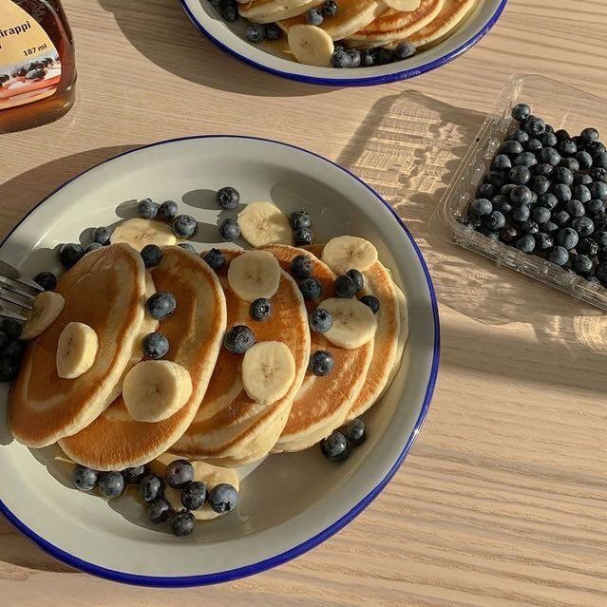
Hostel Froodie
Vidyut Balaji 19D100025
Prakriti Mehta 19D100013
Vijayant 180100078
Kratik 180100059
Shrey Gupta 190100112
An Innovative meal Planner

Slide 2
01.
ABOUT OUR PRODUCT
02.
OUR MISSION AND DEFINITION
03.
LANDSCAPE ASSESSMENT
04.
SOFTWARE DESIGN
05.
FUTURE PLANS AND ROAD MAPS

Slide 3
01
ABOUT OUR PRODUCT

Slide 4
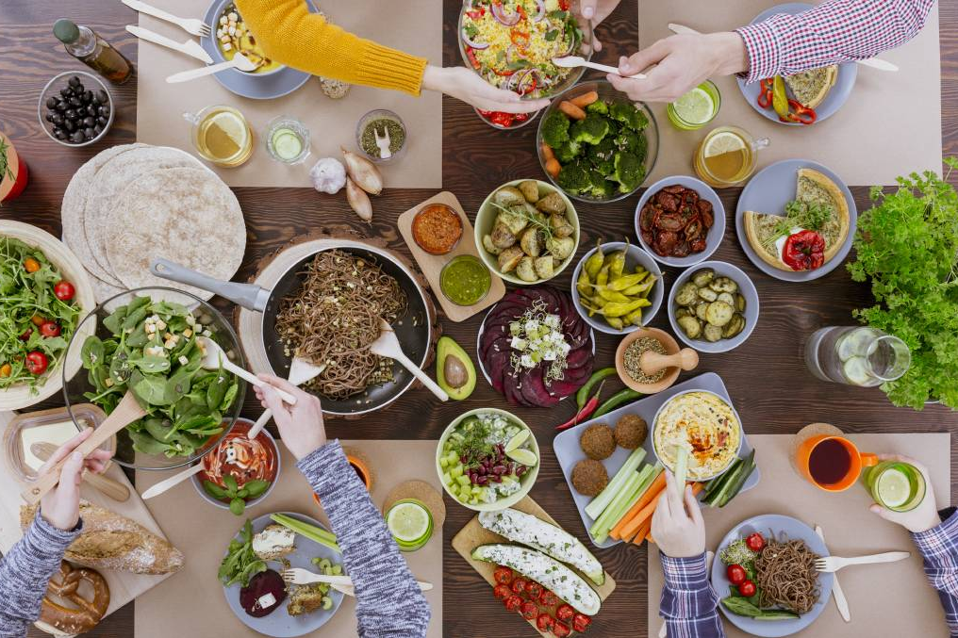
PRODUCT DESCRIPTION
Hostel Froodie is a meal planner designed specifically for the average hostel student who is just learning to live and manage themselves independently.
Through Hostel Froodie, students can experience a balanced diet even after leaving their homes.
Having a flexible and enjoyable meal plan despite having a rigid and bland mess menu

Slide 5
Our Mission, Vision and Goals
Our Mission is to create a college environment where students enjoy and look forward to their mess food while accomplishing their health and fitness goals with ease.
We aim to do this with a software that personalizes meal plans for hostel students based upon their calorie requirements and their preferences, all while being aware of the food available in their mess for any given day.
In the Future, Hostel Froodie would be so highly integrated to the indian college system, that it would be able to keep track of college mess menus on a subcontinent scale. A personalized meal plan that will get updated throughout the day based on the food items user consciously or subconsciously prefers.

Slide 6
02
PRODUCT DEFINITION

Slide 7
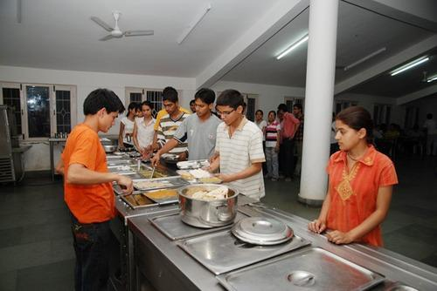
Problem Definition
When students get into college, often undergo drastic physical changes in a matter of months. The main reason for this is not being able to follow a proper meal plan and maintaining a proper meal plan. Often, students are unable to comprehend the nutritional value of the food that is available in the mess and end up eating unhealthily.
There is hence a dire need for a smart meal planner that is flexible and caters to the individual as a college student. We take your weekly mess menu as well as your food logs to generate the best 4 course meal plan for you.
Currently, Available solutions for generating meal plans don’t pay attention to the rigidness of a hostel mess menu in India. Our product is customized for the mess users, giving them the much-needed assistance in planning their meals from available options.

Slide 8
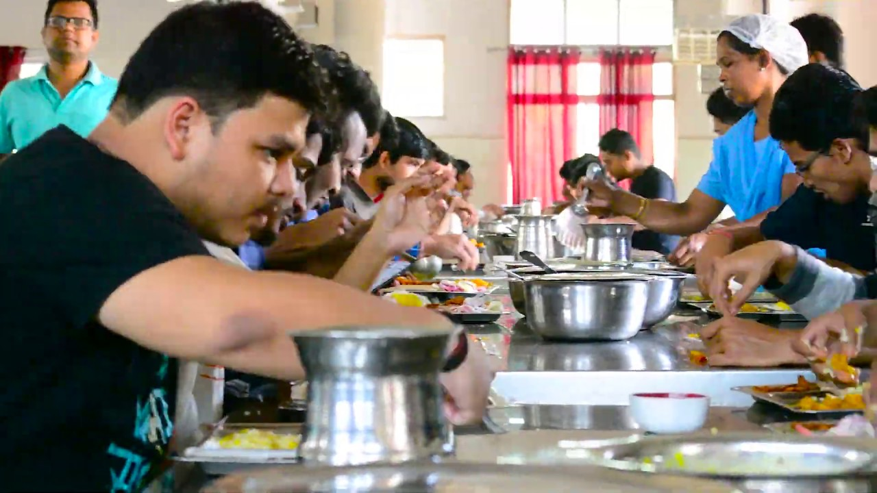

STEPWISE BREAKDOWN OF THE PRODUCT FUNCTION
STEP 1
STEP 2
STEP 3
STEP 4
Input your goals and your current state (BMI, weight, height, etc)
Input the mess menu for the week in the form of a pdf or image
The software predicts the best meal plan for your current meals based on previous weeks
Update what you eat to the product as well as feedback so that the software can learn

Slide 9
03
LANDSCAPE ASSESSMENT

Slide 10
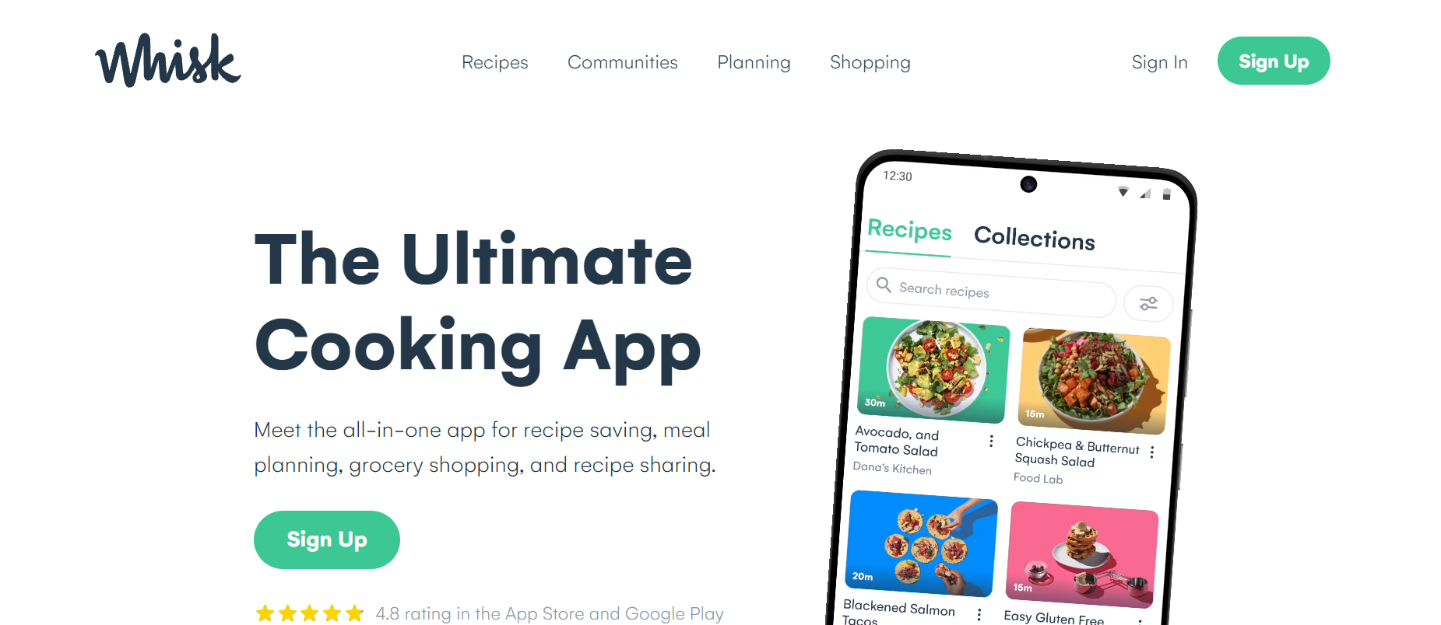
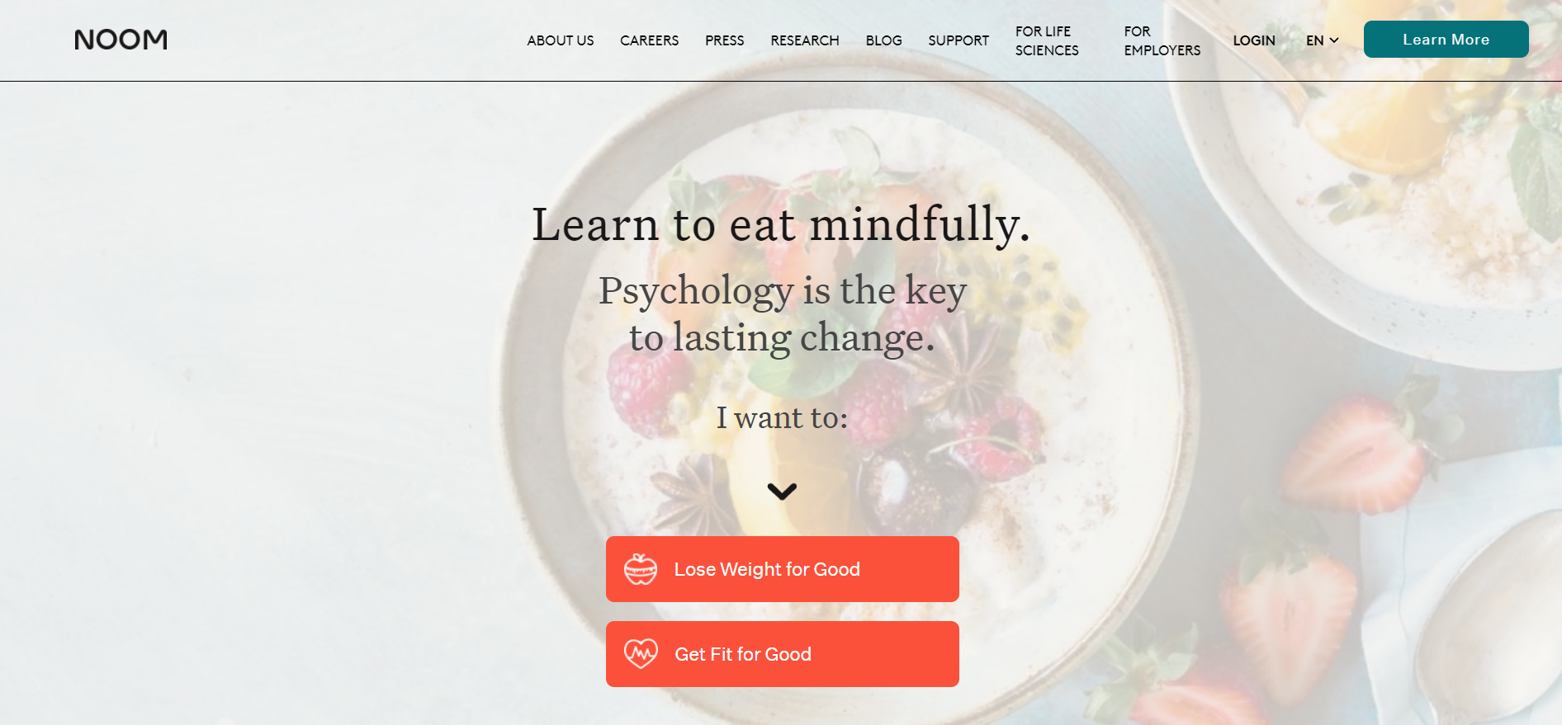
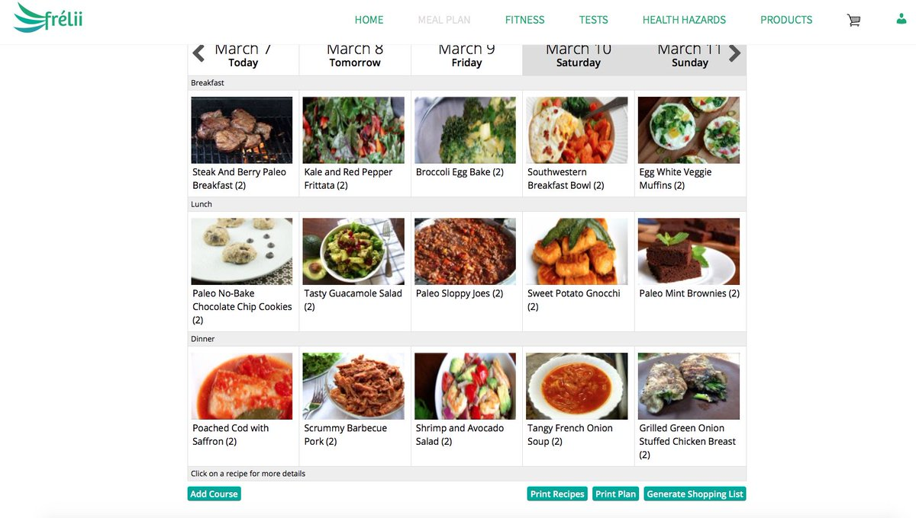

Technology LandScape Assessment
Whisk’s Culinary Coach
Noom
Frélii
Gulpie
AI-powered nutrition platform that provides food recommendations based on flavour preferences and avoidances
A software that takes the user's exercise and food logs
a health tool that uses AI to build unique nutrition and health needs
uses AI to recommend Restaurants and places to eat, to suit the user's diet.

Slide 11
04
SOFTWARE DESIGN

Slide 12
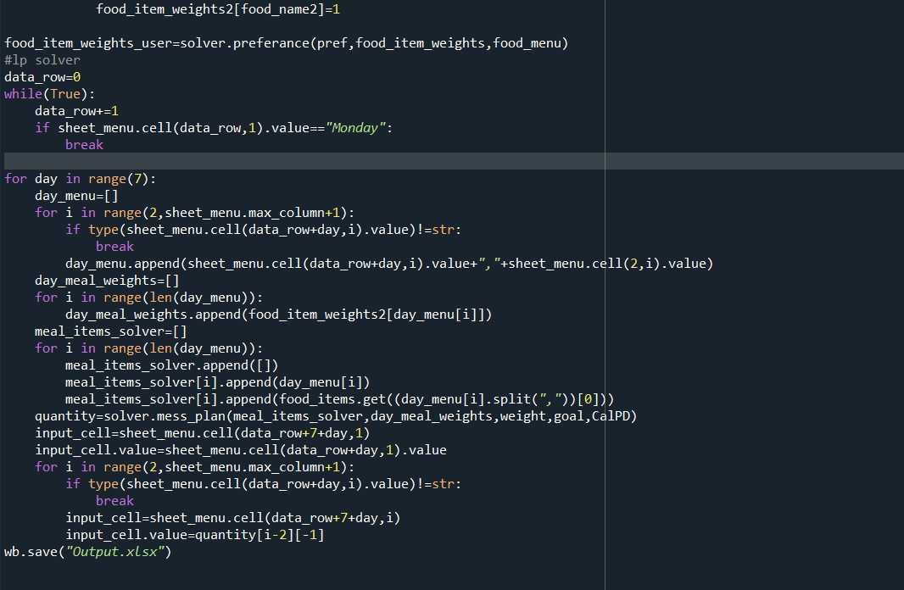
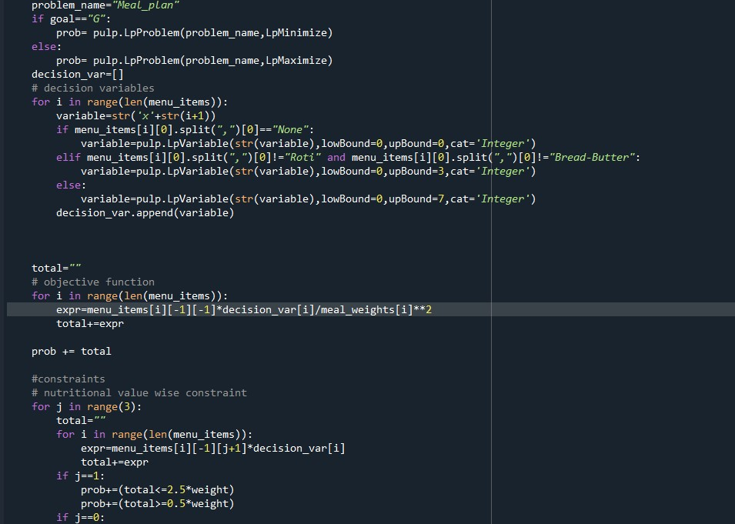
PYTHON SCRIPT FOR PRODUCT PROTOTYPE

Slide 13
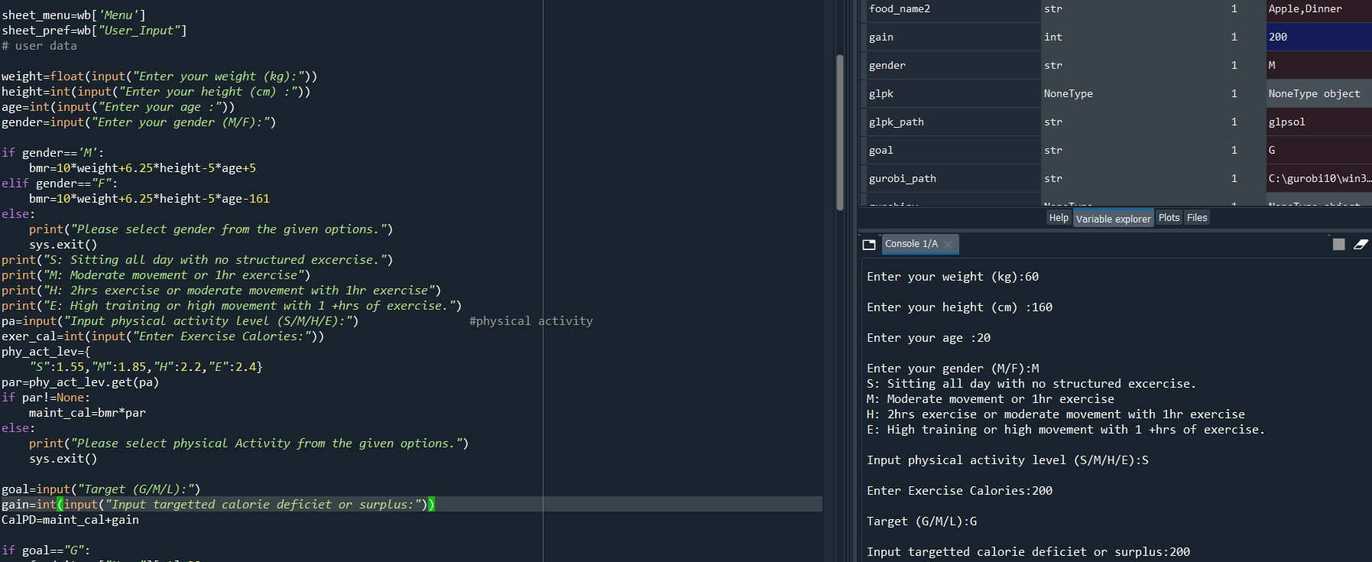
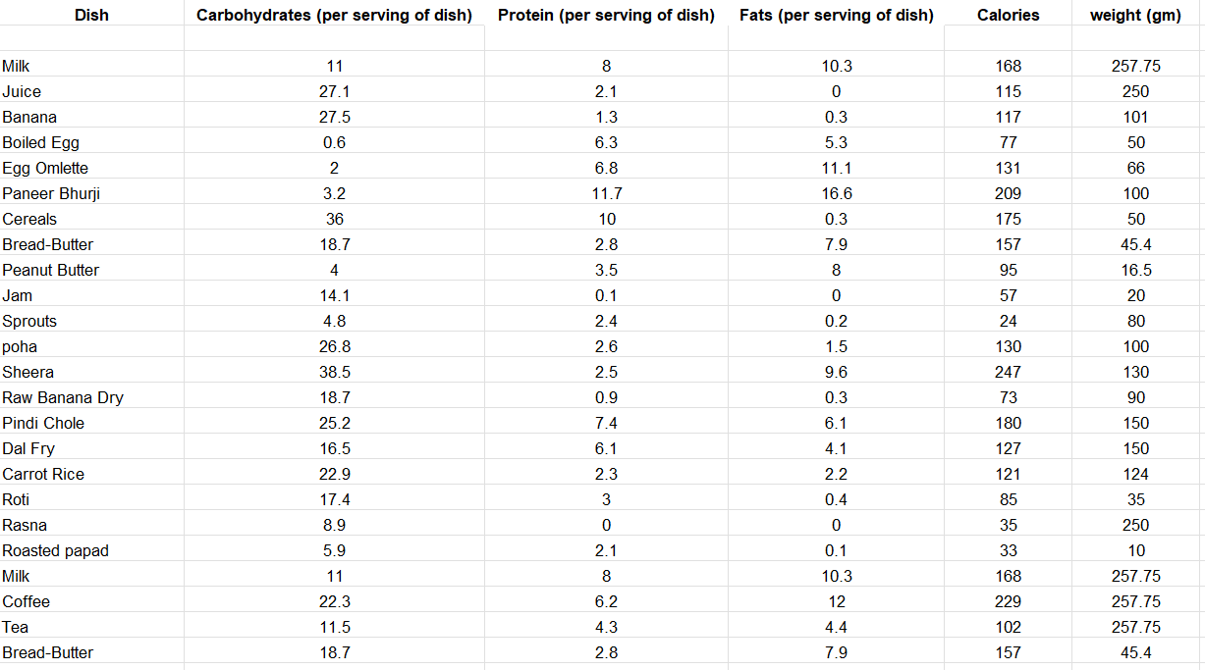
INPUT AND DATA ANALYSIS WITH RUDIMENTARY INTERFACE

Slide 14
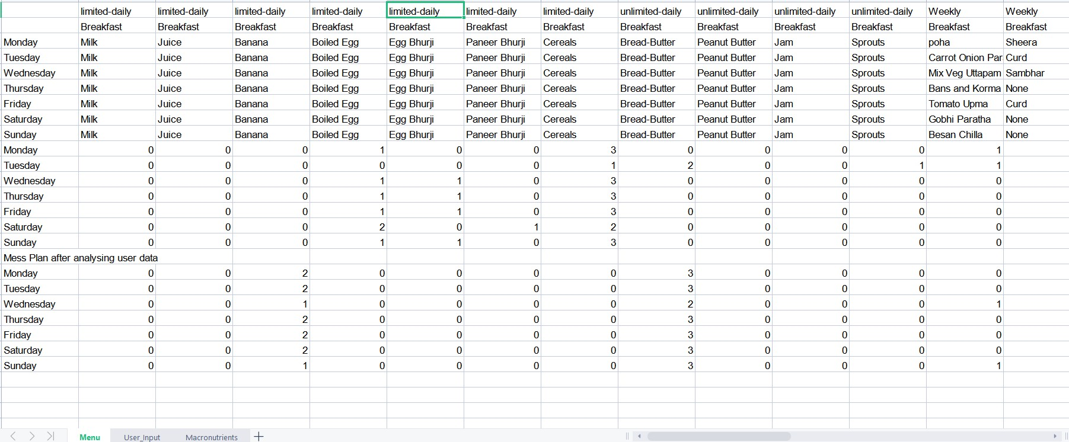
Output Data

Slide 15
05
FUTURE PLANS & ROAD MAP

Slide 16
Goals For the Future of This Product
Currently, we have an extremely rudimentary prototype made as a proof of concept.
We further intend to add additional features like preparing meals and activity plans for a targeted bodyweight and fitness level.
In future, we plan to improve the meal suggestions by analyzing how the user responds to the meal plan. We also intend to collect the data from the user to a central system and provide that data to the mess caterers, so that a closed system can be created, and food wastage is minimized. Our end goal is to make Hostel Froodie the core of every college health system and hostel environment.

Slide 17
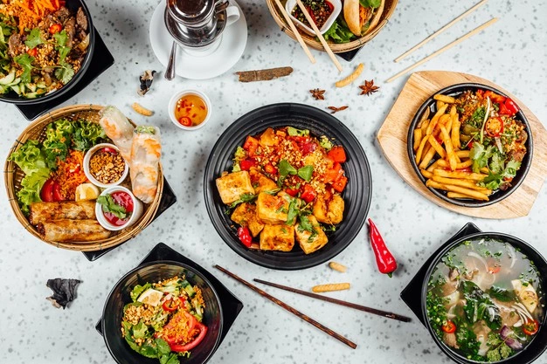
THANK YOU!
OUR TEAM
Vidyut Balaji 19D100025
Prakriti Mehta 19D100013
Vijayant 180100078
Kratik 180100059
Shrey Gupta 190100112

